Slide 1
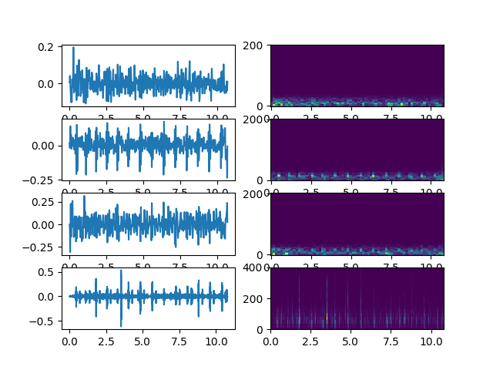
Smartphone data

Slide 2
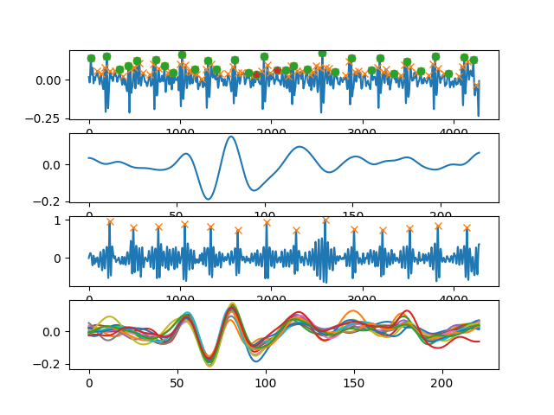
Heartbeat

Slide 3
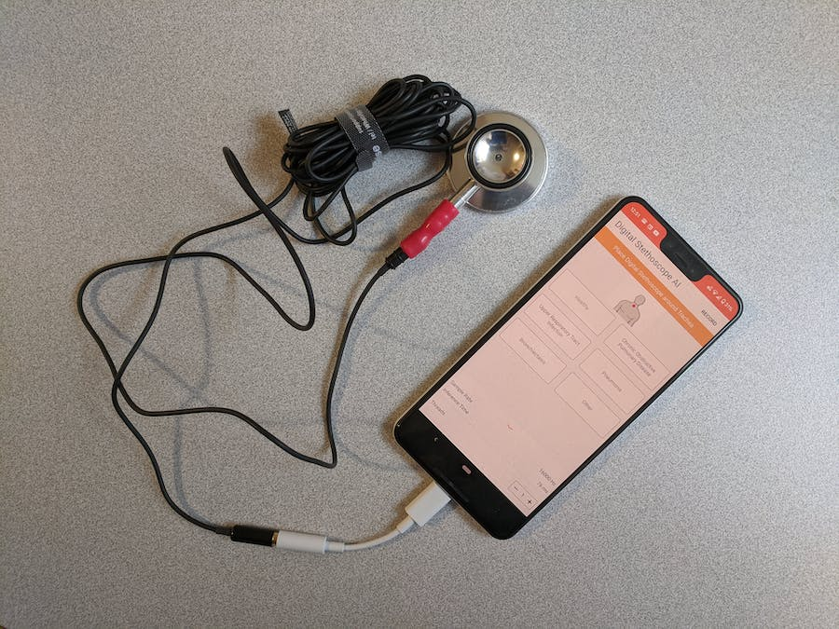
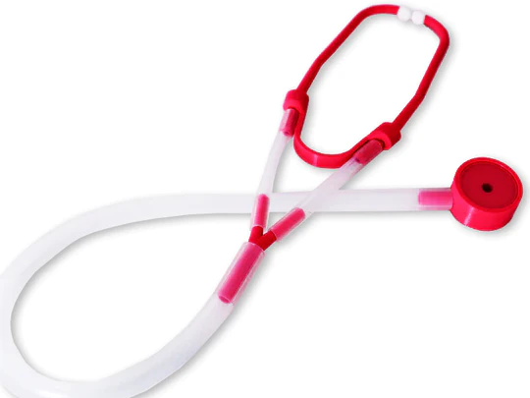
Stethoscope(s)
3M Littmann
Return
Keep, record it with external microphone
Thinklabs stethoscope
Cheap stethoscope

